Slide 1
Chatbot for College

Slide 2
PROBLEM STATEMENT
Campus information is often slow and fragmented. Students, faculty, and staff face delays in accessing crucial updates. This results in frustration, inefficiency, and increased administrative workload. The need for a more efficient, real-time solution is critical.

Slide 3
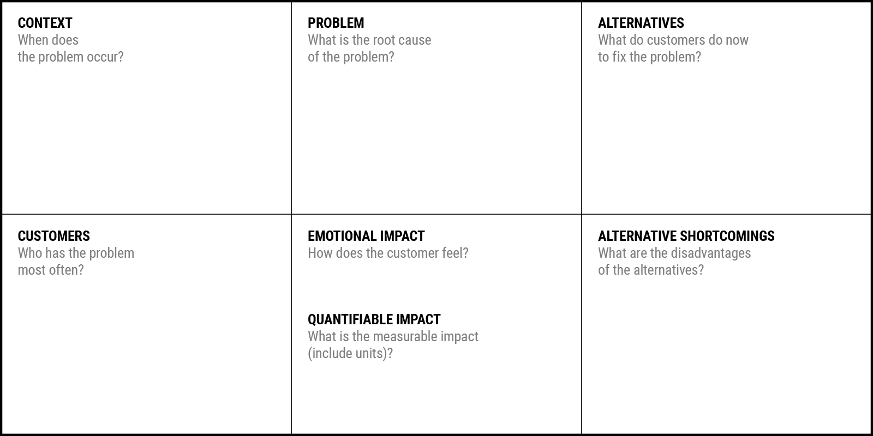
College Chatbot Canvas
Which is your Customer Segment:
Students, faculty, staff, and prospective admissions applicants.
During high demand
for campus information and administrative support.
Limited access to timely, accurate campus-related information resources.
Seek help manually from campus offices and
online resources.
Frustrated , overwhelmed.
Students, especially new and
prospective admissions applicants.
Slow response times, manual effort, and potential information gaps.
High efficiency. 30% faster

Slide 4
Idea & Solution
The college chatbot serves as an interactive assistant for students, faculty, and staff, offering real-time support for admissions, courses,
events, food orders, interview preparation, and administrative tasks.It also provides personalized notifications, past exam papers, and dynamic feedback using NLP and machine learning, promoting seamless campus communication. This system enhances convenience and academic preparation while reducing administrative workload.

Slide 5







Process flow chart prototype
Has
Technology ?

Slide 6
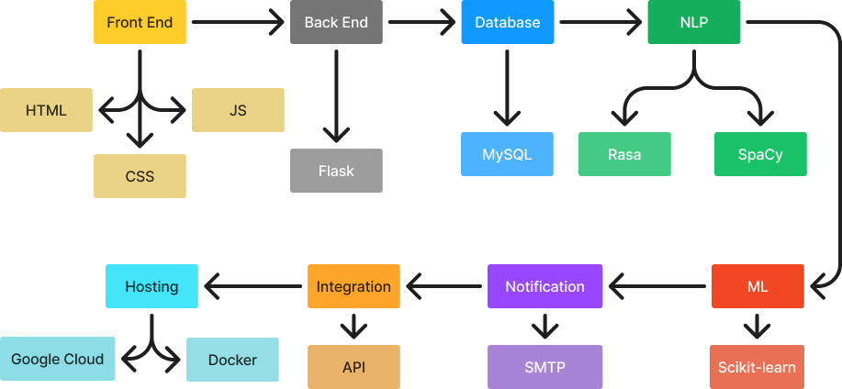
Technology stack

Slide 7
USER CASES
Admissions
Courses
Events
Campus Facilities
Hostel Details
Interview Preparation
Email Notifications
Availability Check
Administrative Processes
Semester / CIAT Questions
Real-Time Support
Feedback
Helpline
Online Food & Snacks Order System

Slide 8
Dependencies / Show stopper
NLP Accuracy:
Chatbot performance depends on effective NLP interpretation.
Database Integration:
Requires seamless access to college databases and APIs.
Exam Paper Repository:
Needs complete and updated past exam papers.
Real-time Food Orders:
Accurate availability tracking is essential for orders.
Email Notifications:
Critical for timely announcements and event updates.
Server Scalability:
Must handle high traffic during peak periods.

